Slide 1
WEEK 8 · LECTURE 16
Agentic Support Copilot
Writing the retrieval pipeline, the agent loop and the interface
It searches your documentation, cites every claim, judges whether it
retrieved enough, and declines when the documentation does not cover it.
Laptops open. We run every cell together, then we look at the jobs that build these systems.
ISBA 2411 · Natural Language Processing & AI · Summer 2026

Slide 2
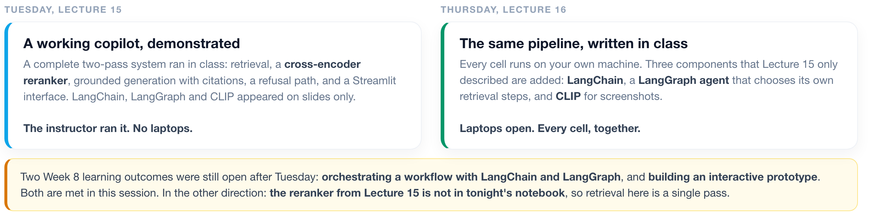
1 The build
2 The jobs
3 The debate
WHERE WE ARE
What Lecture 15 demonstrated, and what this session adds
Same company, same inbox, same models. Two things change: who types, and what is in the pipeline.
ISBA 2411 · Natural Language Processing & AI · Summer 2026

Slide 3
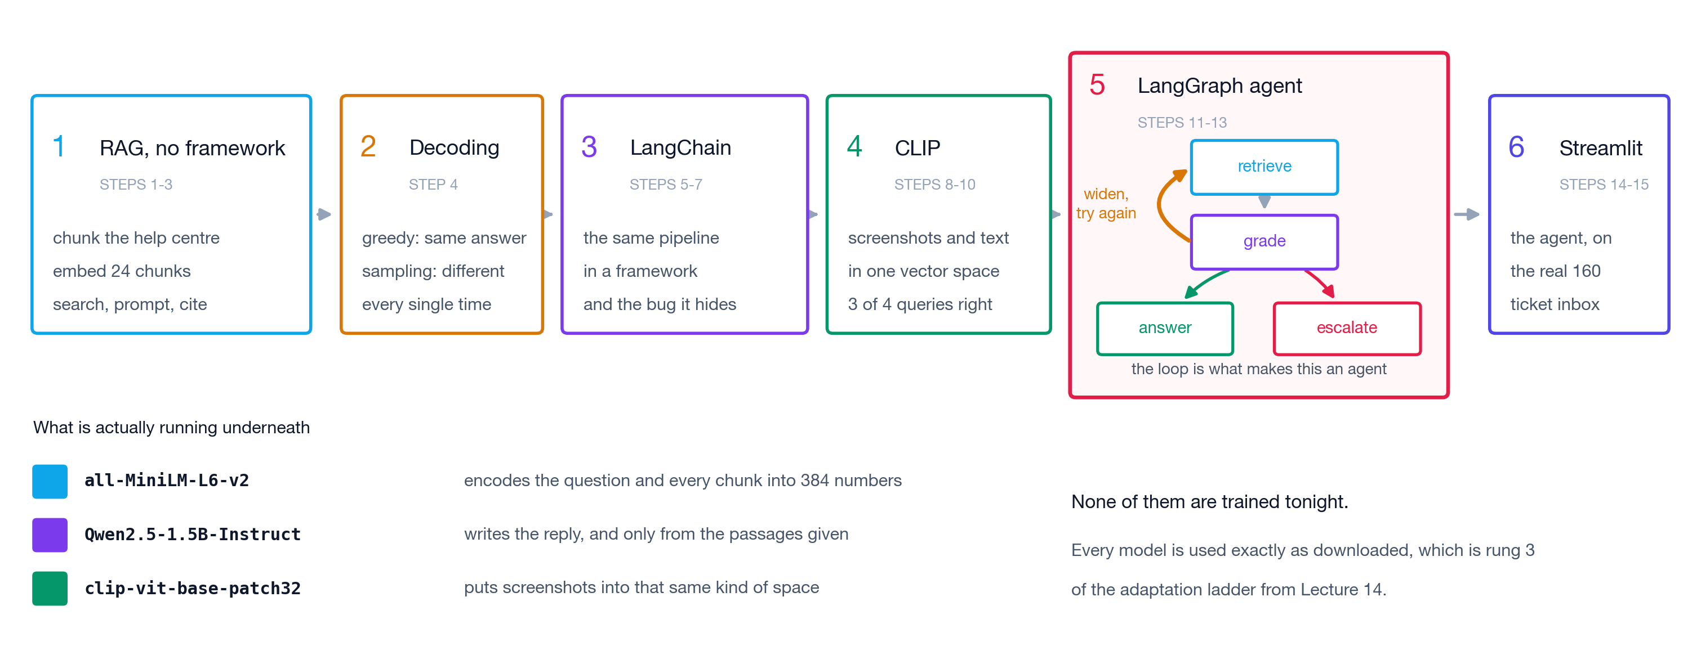
1 The build
2 The jobs
3 The debate
THE NOTEBOOK
Six blocks and fifteen steps, in order
This is the whole session on one slide. Come back to it when you lose the thread.
ISBA 2411 · Natural Language Processing & AI · Summer 2026

Slide 4
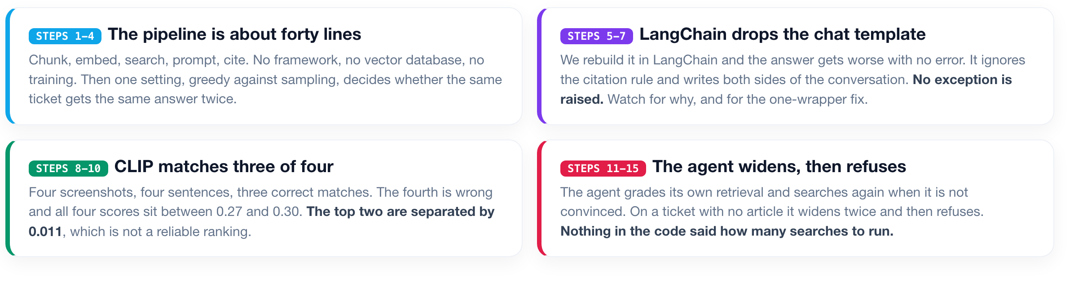
1 The build
2 The jobs
3 The debate
BEFORE WE START
Four results to watch for while we run the cells
Three of the four are failures. They are in the notebook on purpose.
ISBA 2411 · Natural Language Processing & AI · Summer 2026

Slide 5
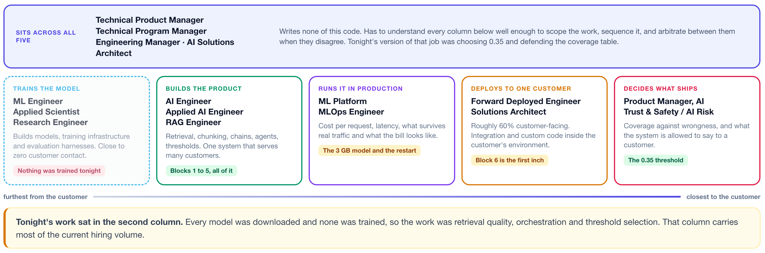
1 The build
2 The jobs
3 The debate
THE JOBS
These jobs differ by distance from the customer, not by title
Titles overlap and shift. Where you sit relative to the customer does not.
ISBA 2411 · Natural Language Processing & AI · Summer 2026

Slide 6
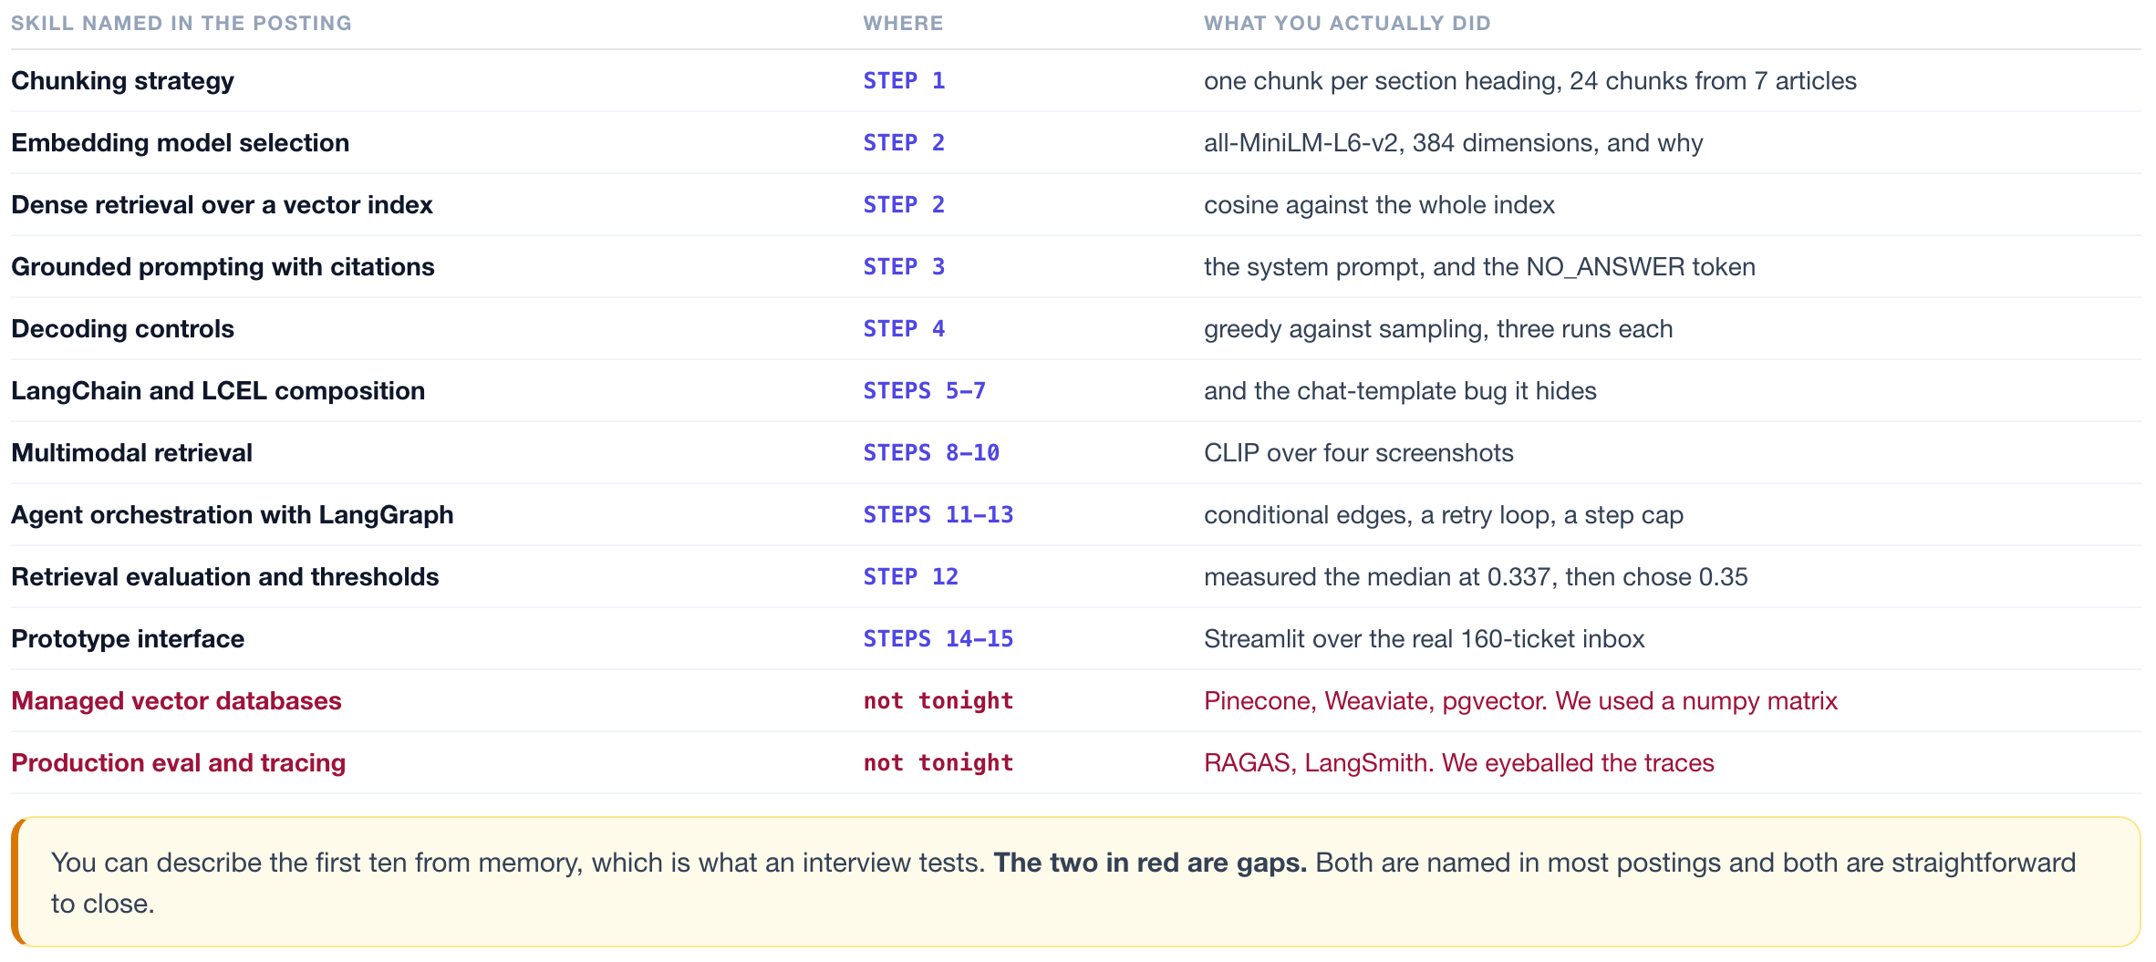
1 The build
2 The jobs
3 The debate
THE JOBS
Skills named in AI Engineer postings, and where you did each
Left column is language from AI Engineer postings. Right column is what you ran.
ISBA 2411 · Natural Language Processing & AI · Summer 2026

Slide 7
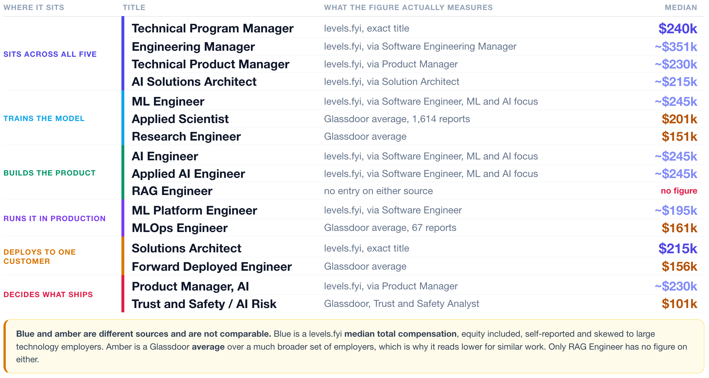
1 The build
2 The jobs
3 The debate
THE JOBS
What each of those titles pays, and where the number comes from
Two sources with different methods. Which one you quote changes the answer by a third.
ISBA 2411 · Natural Language Processing & AI · Summer 2026

Slide 8
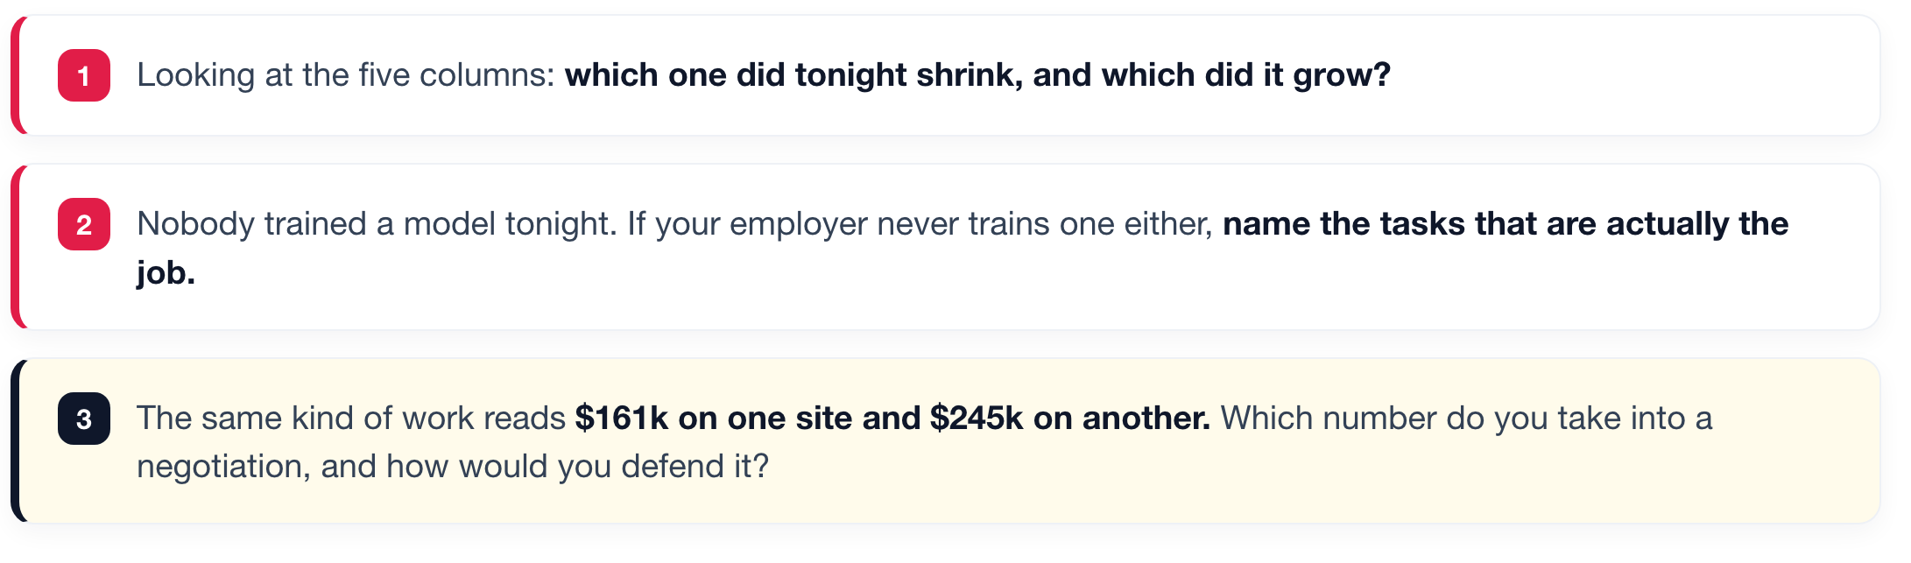
1 The build
2 The jobs
3 The debate
DISCUSSION 1
Which of these jobs did you just automate?
Ten minutes. Argue from the role you would actually want.
ISBA 2411 · Natural Language Processing & AI · Summer 2026

Slide 9
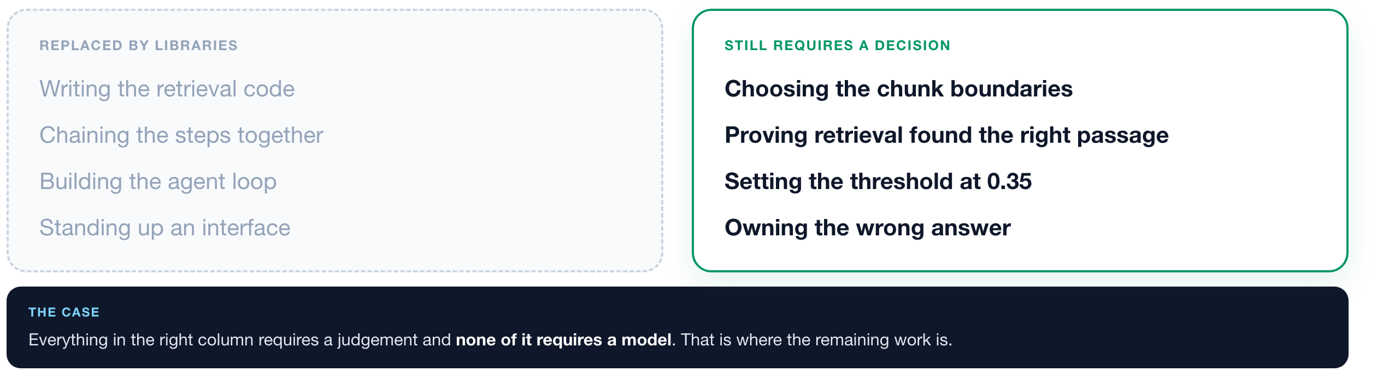
1 The build
2 The jobs
3 The debate
DISCUSSION 1
Which parts of the work the tooling replaced
All three questions on the previous slide come back to this split.
ISBA 2411 · Natural Language Processing & AI · Summer 2026

Slide 10
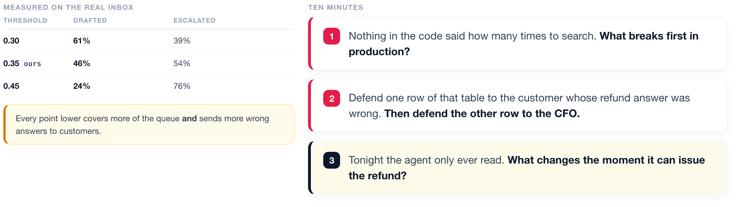
1 The build
2 The jobs
3 The debate
DISCUSSION 2
The threshold decides how much of the queue gets automated
It is not a machine learning question, and somebody has to put their name on it.
ISBA 2411 · Natural Language Processing & AI · Summer 2026

Slide 11
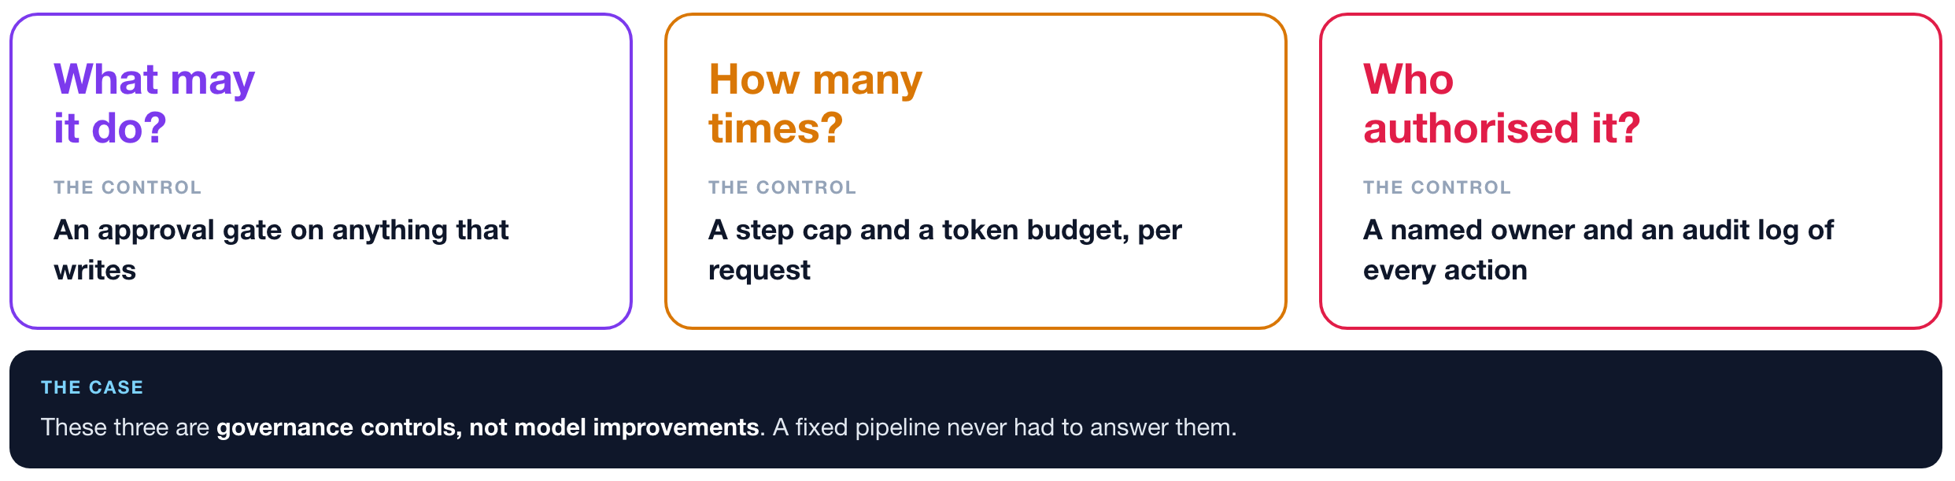
1 The build
2 The jobs
3 The debate
DISCUSSION 2
Three questions an agent introduces, and the control for each
All three are inexpensive to implement and commonly omitted.
ISBA 2411 · Natural Language Processing & AI · Summer 2026

Slide 12
1 The build
2 The jobs
3 The debate
THE DELIVERABLE
What is on the course repo, and what it demonstrates
All of it is on the course repo, and all of it runs.
A retrieval-grounded support agent with citations, a refusal path, multimodal retrieval and a browser interface.
Built on LangChain and LangGraph, running on downloaded weights with no training, evaluated against a real 160-ticket inbox.
Replace the knowledge base with your own documents to reuse this for your final project.
ISBA 2411 · Natural Language Processing & AI · Summer 2026

